Slide 1


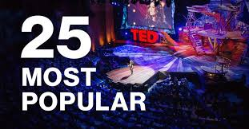
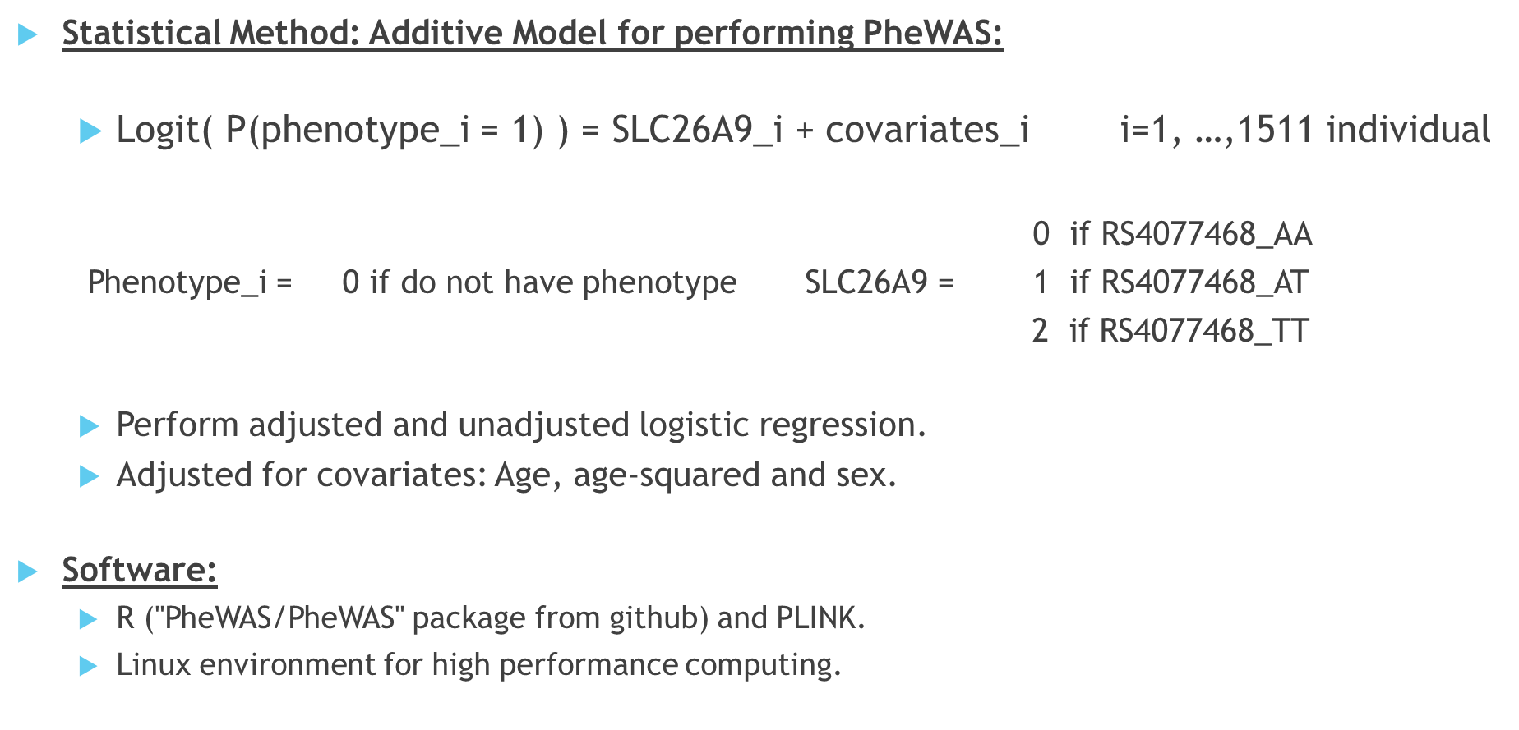
What Makes Ted Talks Popular?
A Deep Dive with Data Science, NLP, and Deep Learning.
Xu Li, Wenting Dai, Faizan K Mohsin, Di Shan, Mona
University of Toronto: Department of Public Health
ABSTRACT
2. METHODOLOGY
3. RESULTS
Add your information, graphs and images to this section.
Add your information, graphs and images to this section.
Add your information, graphs and images to this section.
Add your information, graphs and images to this section.
Phenotypic data
(ICD10 data)
N = 349,590
Genotypic data
N = 488,377
Unrelated Individuals
N = 452,197
Kinship analysis (removed people up to 2nd degree of relatedness)
Caucasians
N = 377,961
Ancestral PCA (removed non-Caucasian individuals)
Final data
N = 263,607
Merged phenotypic data from ICD10 codes with genotypic data
1. INTRODUCTION
Add your information, graphs and images to this section.
4. CONCLUSION
5. ACKNOWLEDGEMENTS
Add your information, graphs and images to this section.

